Slide 1
Quality Attributes
Lecturer: Ngo Huy Bien
Software Engineering Department
Faculty of Information Technology
VNUHCM - University of Science
Ho Chi Minh City, Vietnam
nhbien@fit.hcmus.edu.vn

Slide 2

Objectives
To elicit and document architectural requirements for software system.
To create a simple architectural design to ensure scalability.

Slide 3

Contents
Quality goals.
Quality attributes.
Quality attribute scenarios.
Tactics.

Slide 4

References
Len Bass, Paul Clements and Rick Kazman (2021). Software Architecture in Practice. Addison-Wesley.
R. Kazman, M. Klein and P. Clements (1998). Evaluating Software Architectures for Real-Time Systems.
Rick Kazman, Mark Klein and Paul Clements (2000). ATAM: Method for Architecture Evaluation.

Slide 5
Functionality [1]
Functionality is the ability of the system to do the work for which it was intended.
If functionality were the only thing that mattered, you wouldn't have to divide the system into pieces at all; a single monolithic blob with no internal structure would do just fine.
But although functionality is independent of any particular structure, functionality is achieved by assigning responsibilities to architectural elements, resulting in one of the most basic of architectural structures.
The architect's interest in functionality is in how it interacts with and constrains other qualities.

Slide 6
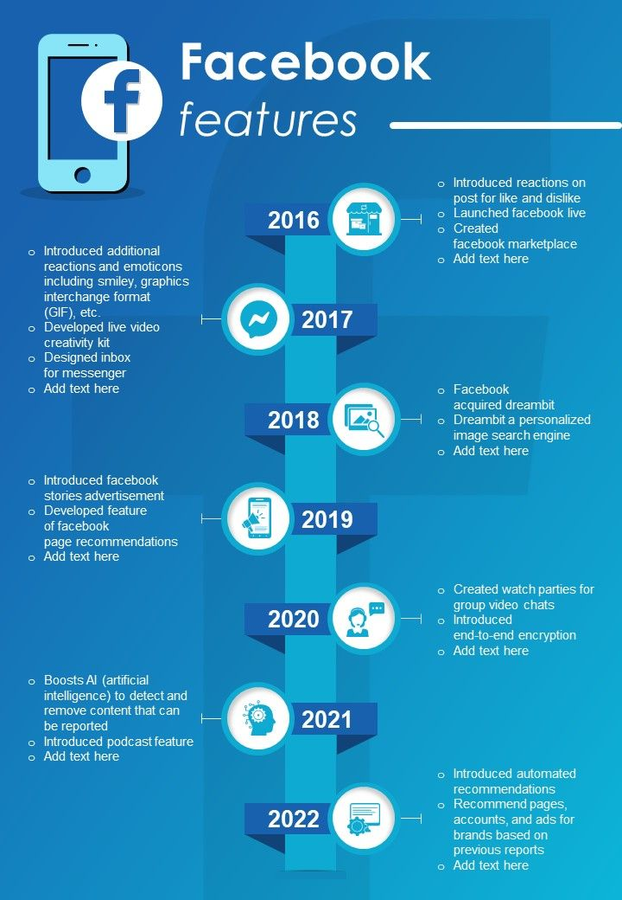
Example: Facebook Functionalities
Registration
Login
Profile
Posts
Timeline
Friends
Likes
Comments
Images
Videos

Slide 7

Quality Requirements
Scalability
Availability
Performance
Security
Modifiability
Extensibility
If a complex system fails to meet the quality requirements, it is useless.

Slide 8

Exercise: Scalability
200,000 requests in 5 minutes.
How to test scalability?
JMeter
Pingdom
How to achieve scalability?
Load balancing (nginx, HAProxy)
Caching (Redis, Memcached)
Exercise: Create an architectural diagram to ensure scalability.
Browsers, load balancer, web servers, database server, cache servers.

Slide 9


Slide 10
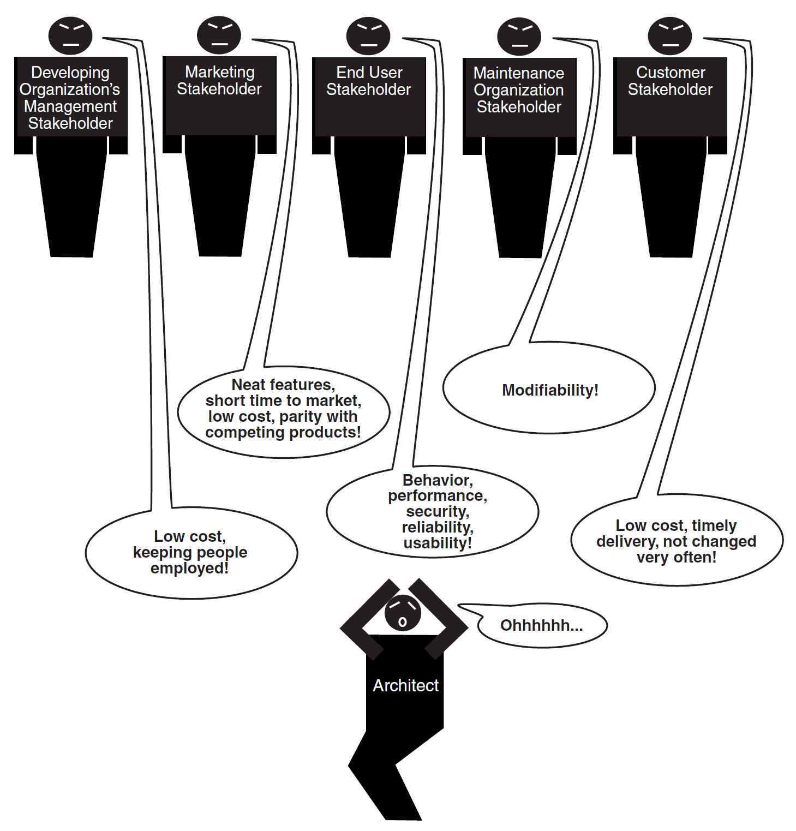
Stakeholders' Goals

Slide 11

Quality Goals [2]
Quality goals form the basis for architectural evaluation, but quality goals by themselves are not a sufficient basis to judge an architecture for suitability.
The system shall be robust.
The system shall be highly modifiable.
The system shall be secure from unauthorized break-in.
The system shall exhibit acceptable performance.
Rabbit or Duck

Slide 12


Measuring Quality Attribute [3]
Evaluating an architectural design against quality attribute requirements necessitates a precise characterization of the quality attributes of concern.
For example, understanding an architecture from the point of view of modifiability requires an understanding of how to measure or observe modifiability and an understanding of how various types of architectural decisions impact this measure.

Slide 13
Quality Attribute Characterizations
Quality attribute characterizations answer the following questions about each attribute:
What are the stimuli to which the architecture must respond?
External stimuli (or just stimuli for short) are the events that cause the architecture to respond or change.
What is the measurable or observable manifestation of the quality attribute by which its achievement is judged?
What are the key architectural decisions that impact achieving the attribute requirement?
Architectural decisions are those aspects of an architecture — components, connectors, and their properties—that have a direct impact on achieving attribute responses.

Slide 14

Example Quality Attribute: Performance
For example, the external stimuli for performance are events such as messages, interrupts, or user keystrokes that result in computation being initiated.
Performance architectural decisions include processor and network arbitration mechanisms; concurrency structures including processes, threads, and processors; and properties including process priorities and execution times.
Responses are characterized by measurable quantities such as latency and throughput.

Slide 15
1. Record PC information
Get-ComputerInfo |
Select-Object WindowsProductName, WindowsVersion, OsArchitecture,
CsManufacturer, CsModel, CsProcessors, CsTotalPhysicalMemory |
Format-List |
Out-File system-info.txt
Get-CimInstance Win32_Processor |
Format-List Name, NumberOfCores, NumberOfLogicalProcessors,
MaxClockSpeed |
Out-File cpu-info.txt
Get-CimInstance Win32_PhysicalMemory |
Format-Table Manufacturer, PartNumber, Capacity, Speed,
ConfiguredClockSpeed |
Out-File ram-info.txt

Slide 16
2. Install the benchmark tools (I)
# In Windows PowerShell:
cd C:\Users\admin\Downloads
choco --version
git --version
## LLVM is a compiler infrastructure that includes tools such as Clang for compiling C, C++, and related languages.
choco install llvm -y
## Restart PowerShell
clang --version
7z
## iperf3 is a command-line tool for measuring network throughput, jitter, packet loss, and connection quality between two computers.
choco install iperf3 -y
iperf3 --version

Slide 17
3. Install the benchmark tools (II)
## fio (Flexible I/O Tester) is a command-line tool for benchmarking and stress-testing storage devices by measuring throughput, IOPS, and latency under configurable disk I/O workloads.
choco install fio -y
fio --version
## jq is a command-line tool for parsing, querying, transforming, and formatting JSON data.
choco install jq -y
jq --version
## STREAM is not packaged consistently, so build it from source.
git clone https://github.com/jeffhammond/STREAM.git
cd STREAM
clang -O3 stream.c -o stream (Ask Claude Code to fix build errors without using WSL and download files only to the source folder if necessary)
.\stream.exe

Slide 18
4. Record MacBook information
system_profiler SPHardwareDataType > system-info.txt
system_profiler SPMemoryDataType > ram-info.txt
system_profiler SPNVMeDataType > disk-info.txt
system_profiler SPNetworkDataType > network-info.txt

Slide 19
5. Install the benchmark tools (I)
# In Terminal on macOS over SSH:
git --version
7zz
## fio (Flexible I/O Tester) is a command-line tool for benchmarking and stress-testing storage devices by measuring throughput, IOPS, and latency under configurable disk I/O workloads.
brew install fio
fio --version
## iperf3 is a command-line tool for measuring network throughput, jitter, packet loss, and connection quality between two computers.
choco install iperf3 -y
iperf3 --version

Slide 20
6. Install the benchmark tools (II)
## jq is a command-line tool for parsing, querying, transforming, and formatting JSON data.
brew install jq
jq --version
## STREAM is not packaged consistently, so build it from source.
git clone https://github.com/jeffhammond/STREAM.git
cd STREAM
clang -O3 stream.c -o stream
./stream

Slide 21
7. Run the CPU benchmark
# In Windows PowerShell:
1..3 | ForEach-Object {
& "C:\Program Files\7-Zip\7z.exe" b `
| Tee-Object -FilePath "cpu-run-$_.txt"
Start-Sleep -Seconds 60
}
# In Terminal on macOS over SSH:
for run in 1 2 3; do
7zz b | tee "cpu-run-$run.txt"
sleep 60
done

Slide 22
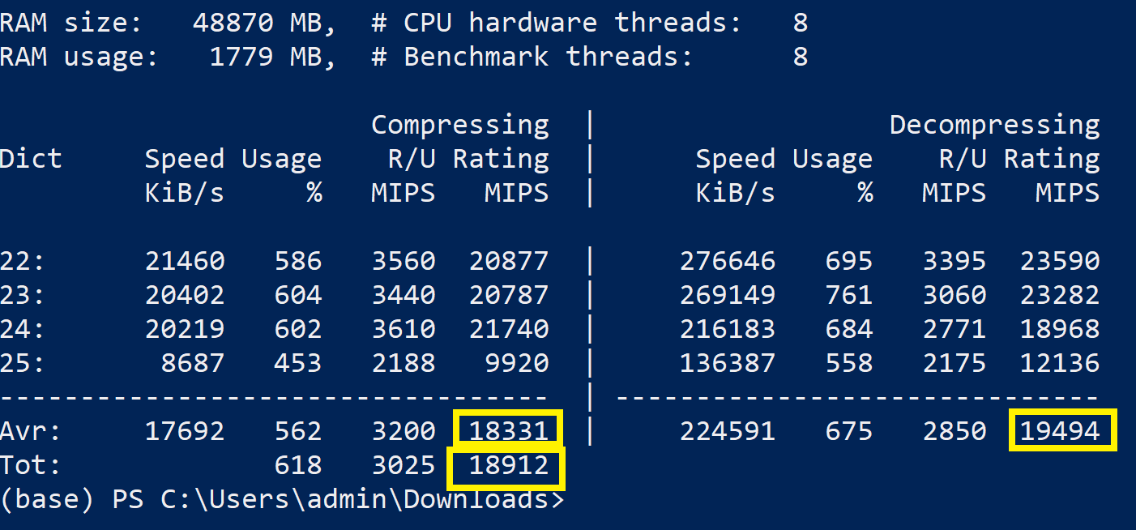
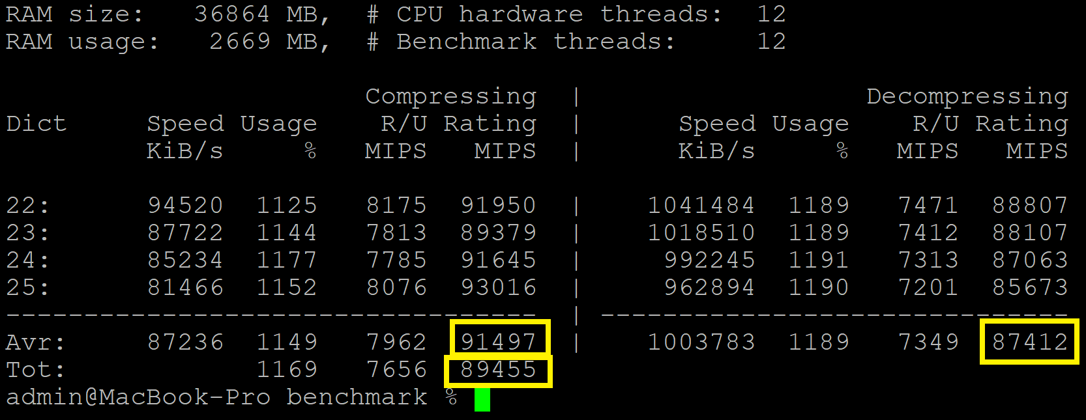
8. Interpret the CPU benchmark results
Look near the bottom of each result for:
Compressing
Decompressing
Total Rating
Higher ratings are better.

Slide 23
9. Run the RAM benchmark
# In Windows PowerShell:
.\stream.exe | Tee-Object stream-pc-run1.txt
.\stream.exe | Tee-Object stream-pc-run2.txt
.\stream.exe | Tee-Object stream-pc-run3.txt
# In Terminal on macOS over SSH:
./stream | tee stream-mac-run1.txt
./stream | tee stream-mac-run2.txt
./stream | tee stream-mac-run3.txt

Slide 24
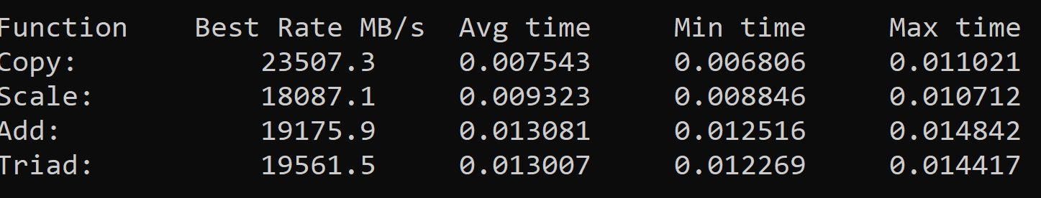
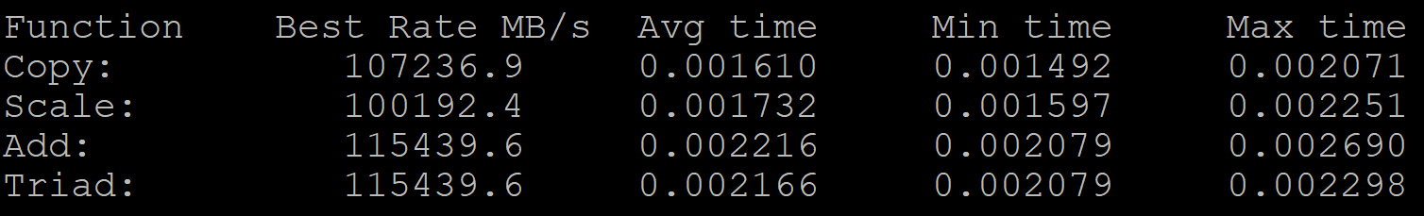
10. Interpret the RAM benchmark results
Copy: memory copy bandwidth
Scale: read, multiply, and write
Add: two reads and one write
Triad: two reads, one multiply, one add, and one write (the most representative overall)
Use Triad as the primary comparison.
STREAM developers recommend Triad because it represents a realistic memory-intensive workload involving both reads and writes. The other operations provide additional context:
Upload the result files and ask ChatGPT to calaculte and compare RAM benchmark results.

Slide 25

Example Quality Attribute: Modifiability
For modifiability, the external stimuli are change requests to the system's software.
Architectural decisions include encapsulation and indirection mechanisms, and
the response is measured in terms of the number of affected components, connectors, and interfaces and the amount of effort involved in changing these affected elements.

Slide 26
Why Use Attribute Characterizations?
The attribute characterizations help to ensure attribute coverage as well as offering a rationale for asking elicitation questions. (REQUIREMENTS ELICITATION)
Examples of performance related questions:
What is the physical location of the hardware and its connectivity?
What are the bandwidth characteristics of the network?
Do you use a synchronous or an asynchronous protocol?
What is the location of firewalls and their impact on performance?
What information is cached versus regenerated? Based upon what principles?
How are resources allocated to service requests?
How do we characterize client loading, (e.g., how many concurrent sessions, how many users)?
What are the performance characteristics of the middleware: load balancing, monitoring, reconfiguring services to resources?

Slide 28
Scenarios
Typically the first job of an architecture analysis is to precisely elicit the specific quality goals against which the architecture will be judged. The mechanism that we use for this elicitation is the scenario.
A scenario is a short statement describing an interaction of one of the stakeholders with the system.
A user would describe using the system to perform some task; his scenarios would very much resemble use cases in object-oriented parlance.
A maintainer would describe making a change to the system, such as upgrading the operating system in a particular way or adding a specific new function.
A developer's scenario might talk about using the architecture to build the system or predict its performance.
A customer's scenario might describe how the architecture is to be re-used for a second product in a product line.

Slide 29
Use Case Scenarios
Use case scenarios describe a user's intended interaction with the completed, running system.
The user wants to examine budgetary and actual data under different fiscal years without re-entering project data. (usability)
User changes graph layout from horizontal to vertical and graph is redrawn in one second. (performance)

Slide 30
Growth Scenarios
Growth scenarios represent typical anticipated future changes to a system.
The maximum number of tracks to be handled by the system doubles and the maximum latency of track data to the screen is kept to 200 ms.
Migrate to a new operating system, or a new release of the existing operating system in less than a person-year of work.

Slide 31
Exploratory Scenarios
Exploratory scenarios push the envelope and stress the system.
Improve the system's availability from 98% to 99.999%.
Half of the servers go down during normal operation without affecting overall system availability.

Slide 32
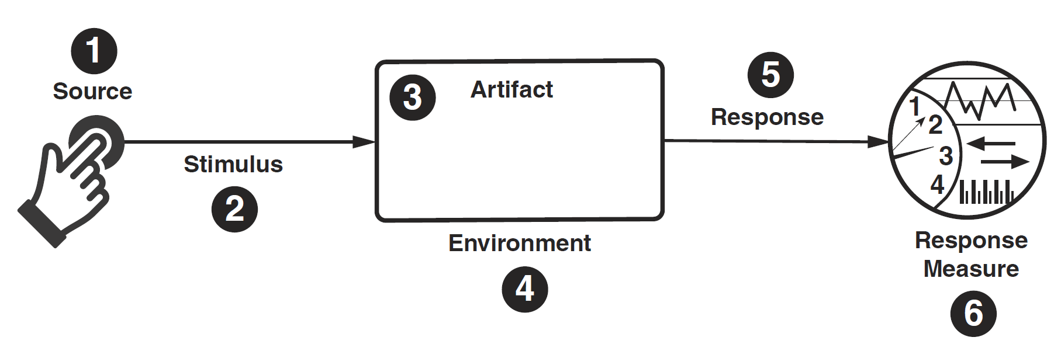
Quality Attribute Scenario Representation [1]
Quality attribute scenarios have six parts: Stimulus, Stimulus Source, Response, Response Measure, Environment, Artifact.
The environment is the set of circumstances in which the scenario takes place.

Slide 33
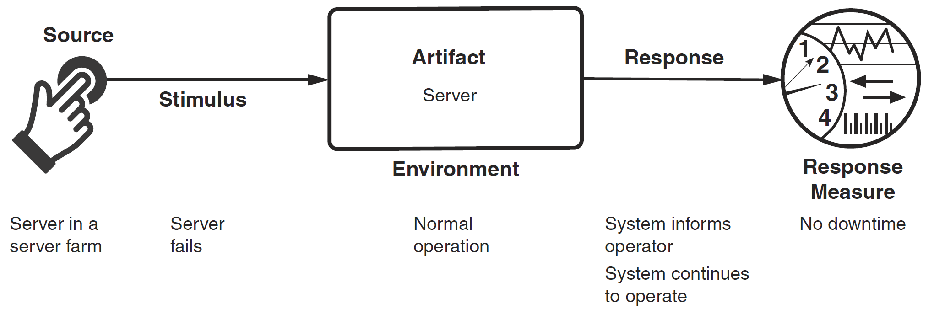
Example: Availability Scenario
Availability refers to a property of software that it is there and ready to carry out its task when you need it to be.
Mean Time Between Failure (MTBF), Mean Time To Recovery (MTTR).

Slide 34
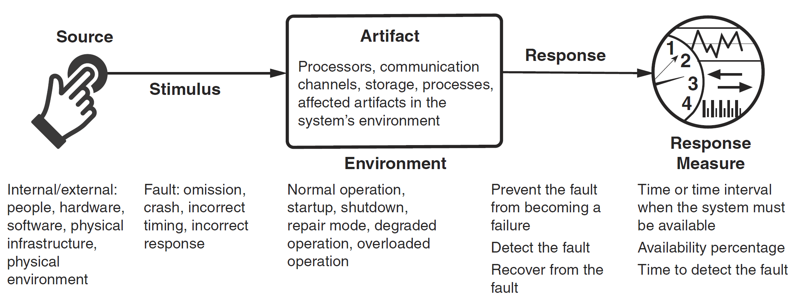
More Complex Availability Scenario

Slide 35
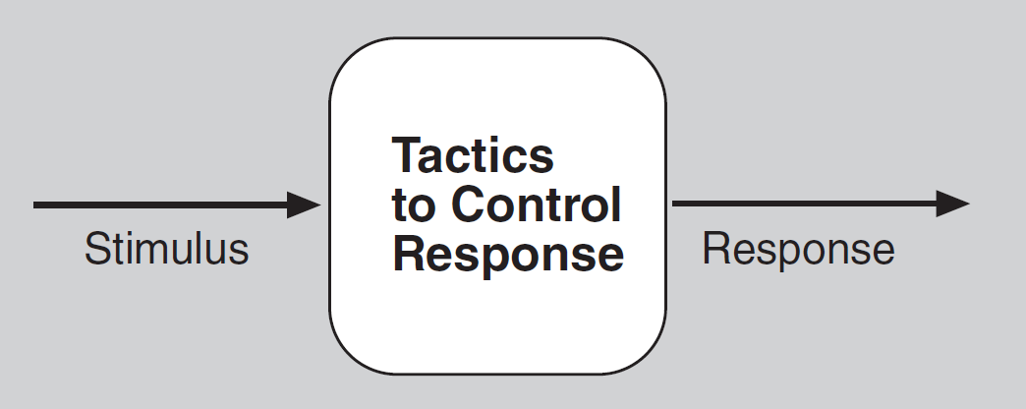
Architectural Tactics
Architectural tactics – the techniques an architect can use to achieve the required quality attributes.
A tactic is a design decision that influences the achievement of a quality attribute response—tactics directly affect the system's response to some stimulus.
If no pattern exists to realize the architect's design goal, tactics allow the architect to construct a design fragment from “first principles.”

Slide 36

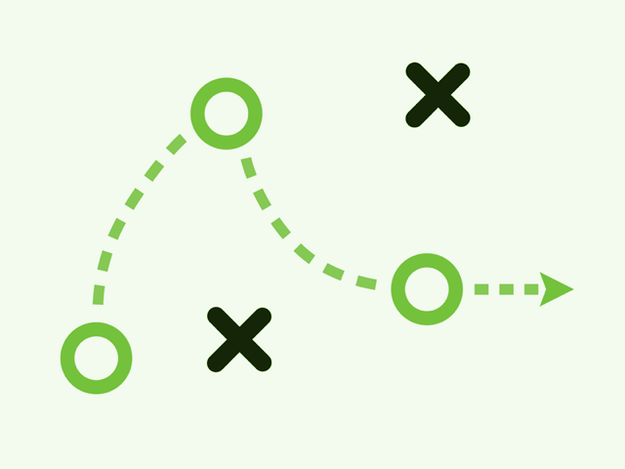
Example: Tactics for Availability
How to design an architecture for availability?
Detect Faults.
Ping/echo.
Monitor.
Heartbeat.
Timeout.
Recover from Faults.
Active redundancy (hot spare).
Passive redundancy (warm spare).
Rollback.
Retry.
Prevent Faults.
Transactions. (ACID properties.)
Exception prevention.

Slide 37

Tools for Testing Availability
https://uptimerobot.com/
https://www.pingdom.com/
https://jmeter.apache.org/

Slide 39
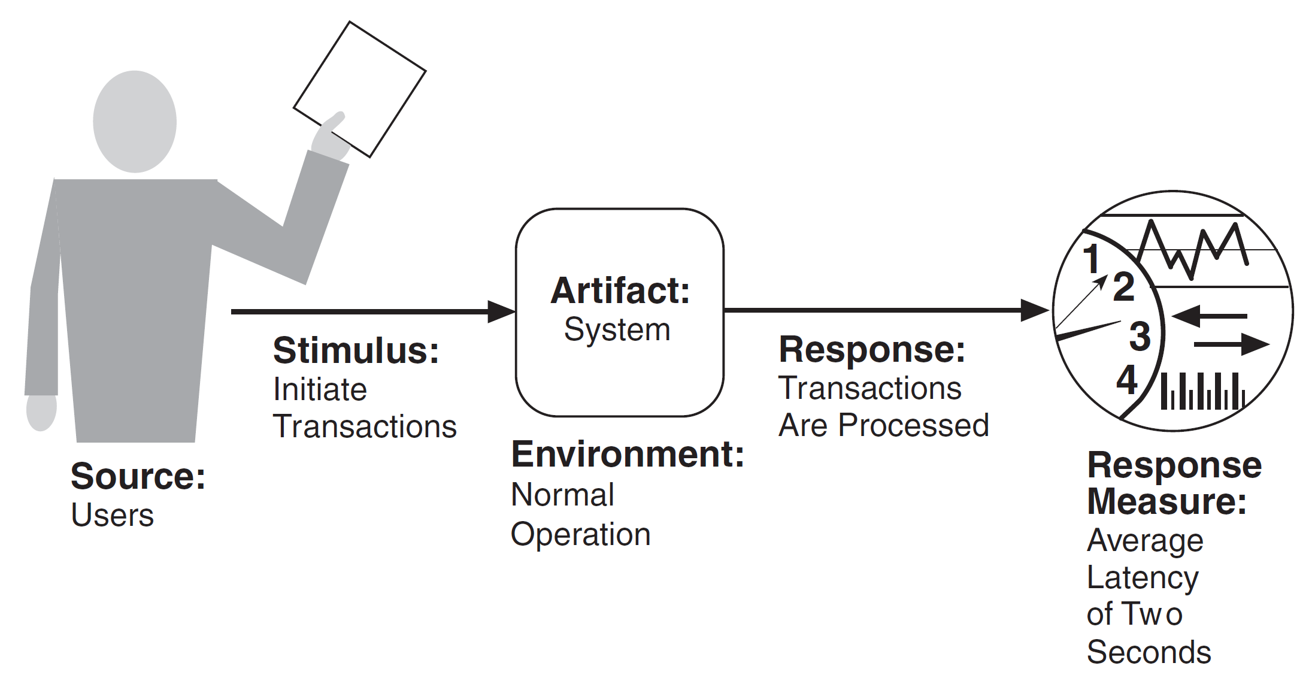
Performance Scenario
Performance, that is: It's about time and the software system's ability to meet timing requirements.

Slide 40
Tactics for Performance
How to design an architecture for performance?
Control Resource Demand.
Manage sampling rate.
Limit event response.
Prioritize events.
Reduce overhead.
Bound execution times.
Increase resource efficiency.
Manage Resources.
Increase resources.
Introduce concurrency.
Maintain multiple copies of computations.
Maintain multiple copies of data.
Bound queue sizes.
Schedule resources.

Slide 41
Tools for Testing Performance
https://developer.android.com/studio/profile
https://developer.apple.com/videos/play/wwdc2019/411/
https://locust.io/
https://k6.io/
https://grafana.com/pricing/?src=k6io#k6-performance-testing

Slide 43

Security Concepts (I)
The simplest approach to characterizing security has three characteristics: confidentiality, integrity, and availability (CIA):
Confidentiality is the property that data or services are protected from unauthorized access. For example, a hacker cannot access your income tax returns on a government computer.
Integrity is the property that data or services are not subject to unauthorized manipulation. For example, your grade has not been changed since your instructor assigned it.
Availability is the property that the system will be available for legitimate use. For example, a denial-of-service attack won't prevent you from ordering book from an online bookstore.

Slide 44
Security Concepts (II)
Other characteristics that are used to support CIA are these:
Authentication verifies the identities of the parties to a transaction and checks if they are truly who they claim to be. For example, when you get an email purporting to come from a bank, authentication guarantees that it actually comes from the bank.
Nonrepudiation guarantees that the sender of a message cannot later deny having sent the message, and that the recipient cannot deny having received the message. For example, you cannot deny ordering something from the Internet, or the merchant cannot disclaim getting your order.
Authorization grants a user the privileges to perform a task. For example, an online banking system authorizes a legitimate user to access his account.

Slide 45
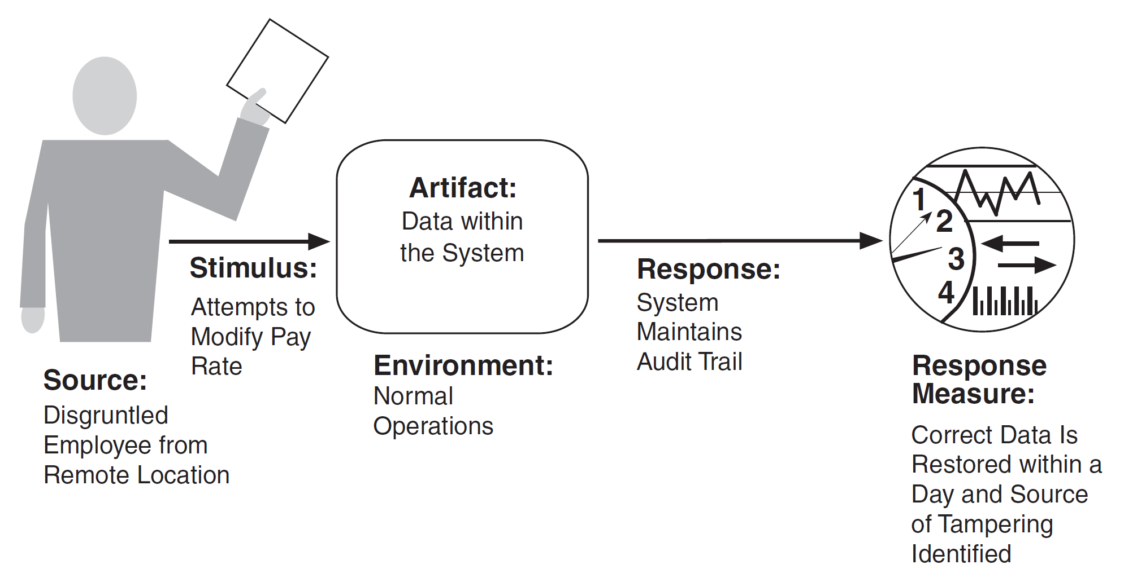
Security Scenario
Security is a measure of the system's ability to protect data and information from unauthorized access while still providing access to people and systems that are authorized.

Slide 46
Tactics for Security
How to design an architecture for security?
Detect Attacks
Detect service denial.
Verify message integrity.
Resist Attacks
Authenticate actors.
Authorize actors.
Limit access.
Limit exposure.
Encrypt data.
Separate entities.
React to Attacks
Revoke access.
Lock computer.
Inform actors.

Slide 47
Tools for Security Testing
https://portswigger.net/burp/pro
https://www.acunetix.com/
https://owasp.org/www-community/Vulnerability_Scanning_Tools

Slide 49
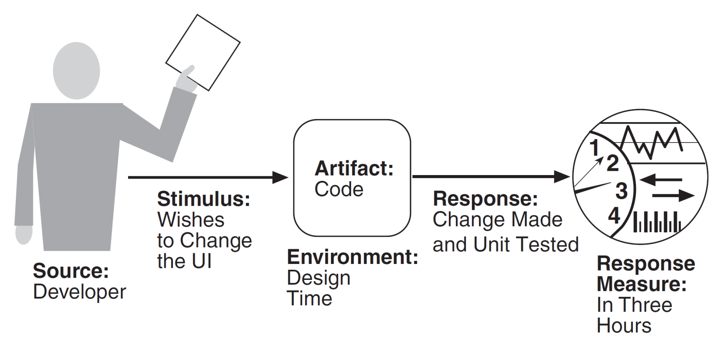
Modifiability Scenario
Modifiability is about change, and our interest in it centers on the cost and risk of making changes.

Slide 50
Tactics for Modifiability
How to design an architecture for modifiability?
Reduce Size of a Module.
Increase Cohesion.
Reduce Coupling.
Defer Binding.

Slide 52
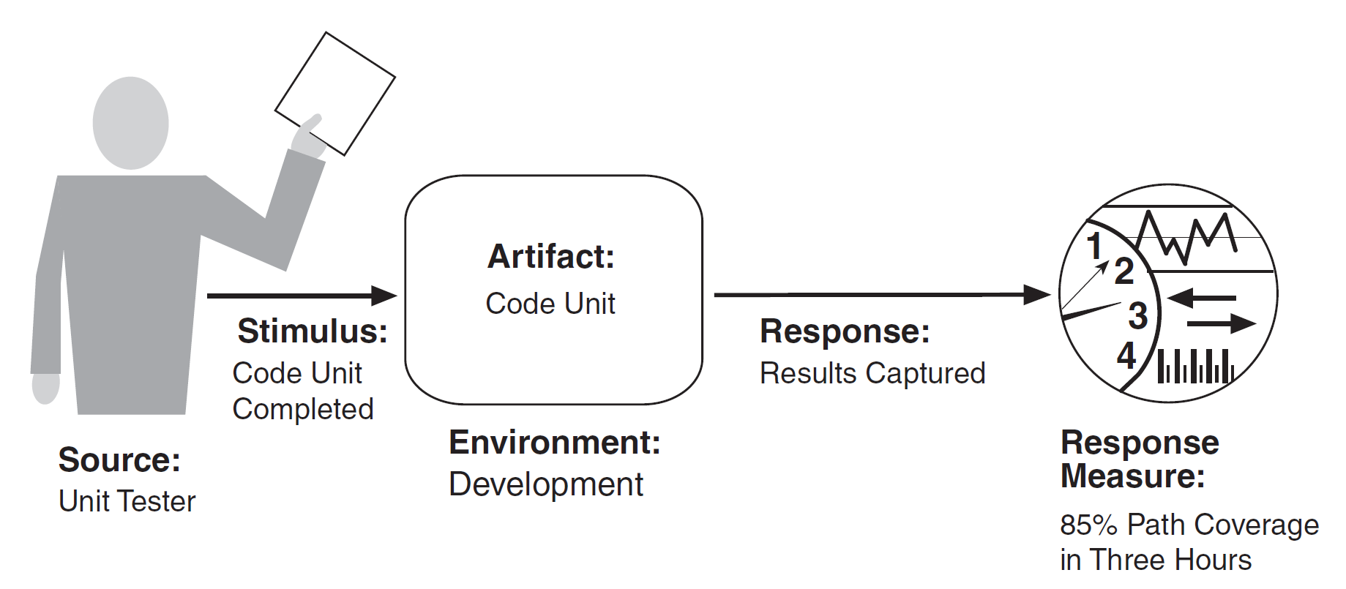
Testability Scenario
Software testability refers to the ease with which software can be made to demonstrate its faults through (typically execution-based) testing.
Intuitively, a system is testable if it “gives up” its faults easily. If a fault is present in a system, then we want it to fail during testing as quickly as possible.

Slide 53
Tactics for Testability
How to design an architecture for testability?
Control and Observe System State
Specialized interfaces
Abstract data sources
Limit Complexity
Limit structural complexity
Limit nondeterminism

Slide 55
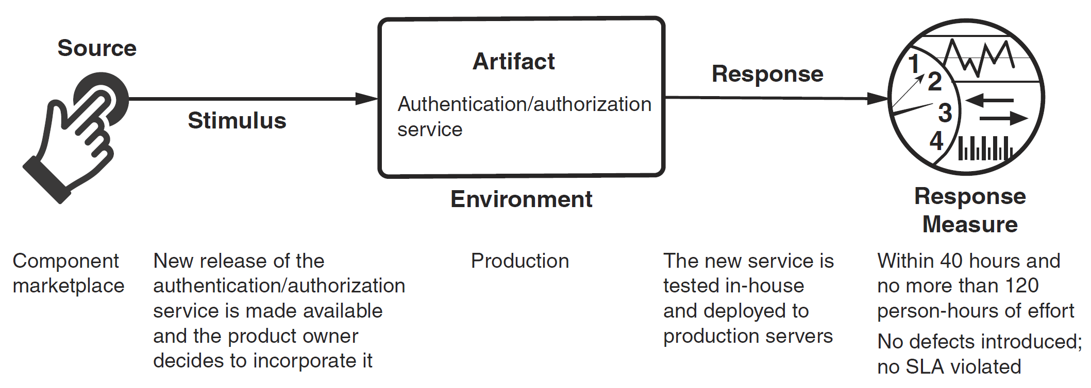
Deployability Scenario
Deployability refers to a property of software indicating that it may be deployed—that is, allocated to an environment for execution—within a predictable and acceptable amount of time and effort.

Slide 56
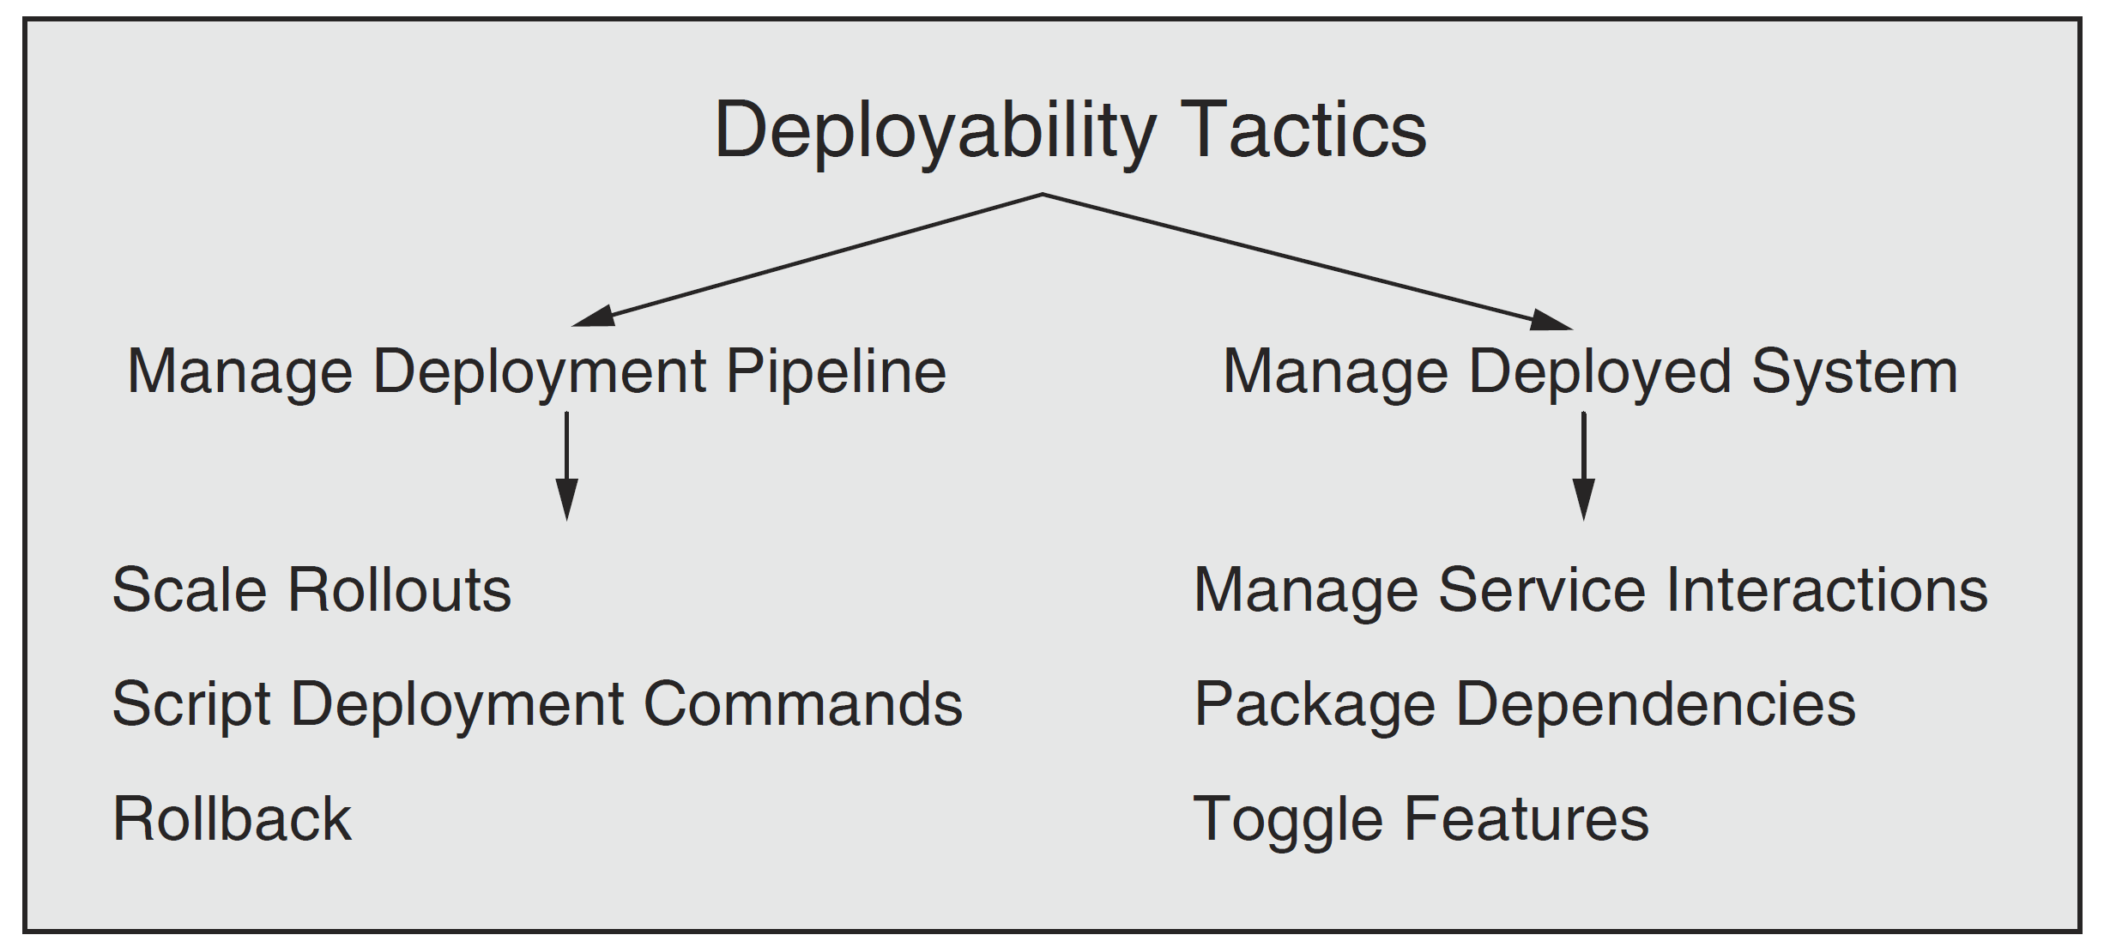
Tactics for Deployability

Slide 58
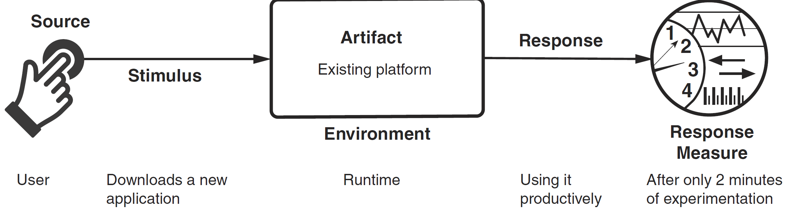
Usability
Usability is concerned with how easy it is for the user to accomplish a desired task and the kind of user support that the system provides.

Slide 59
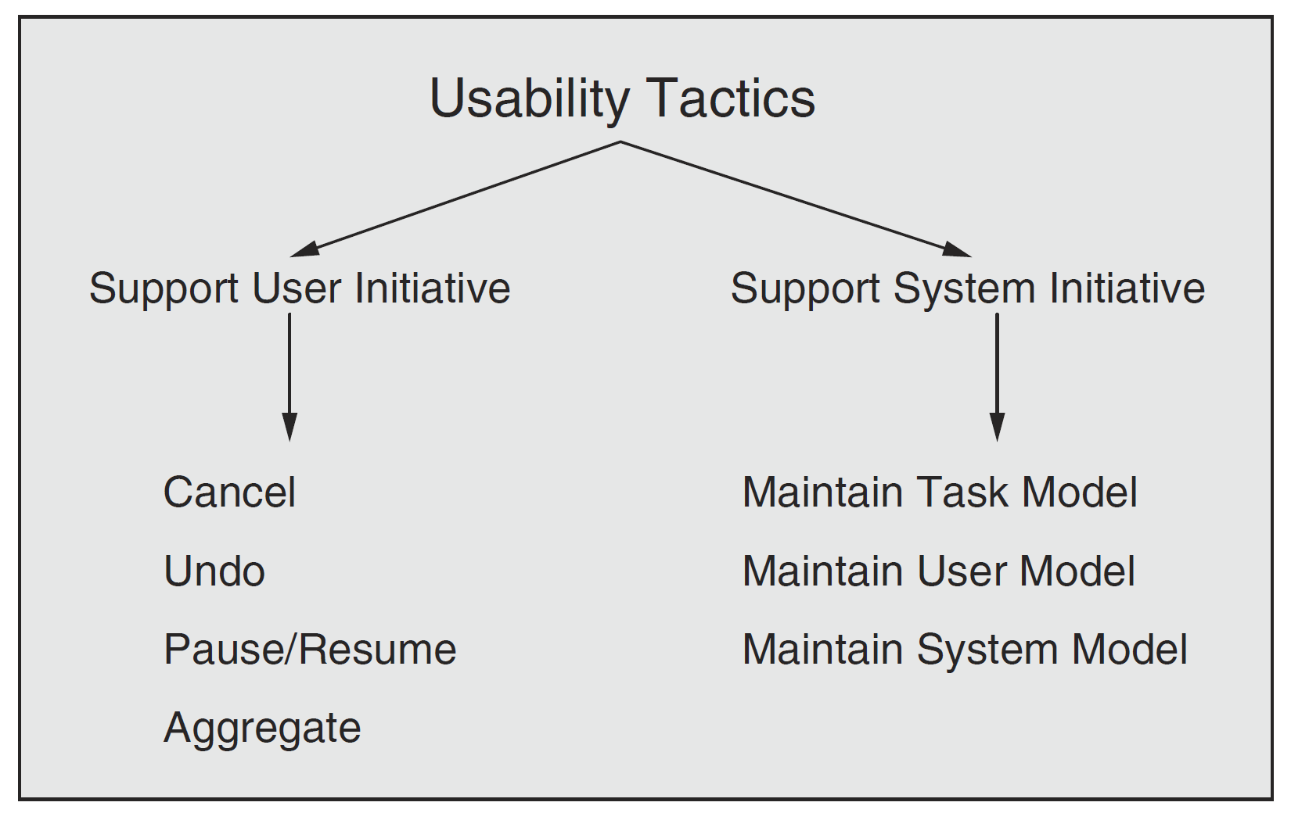
Tactics for Usability

Slide 60
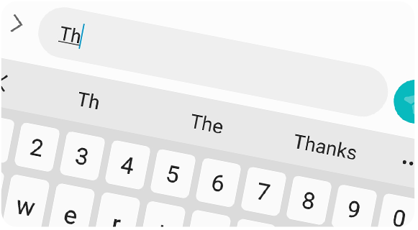
Maintain Task Model
The task model is used to determine context so the system can have some idea of what the user is attempting to do and provide assistance.
For example, many search engines provide predictive type-ahead capabilities, and many mail clients provide spell-correction. Both of these functions are based on task models.

Slide 61
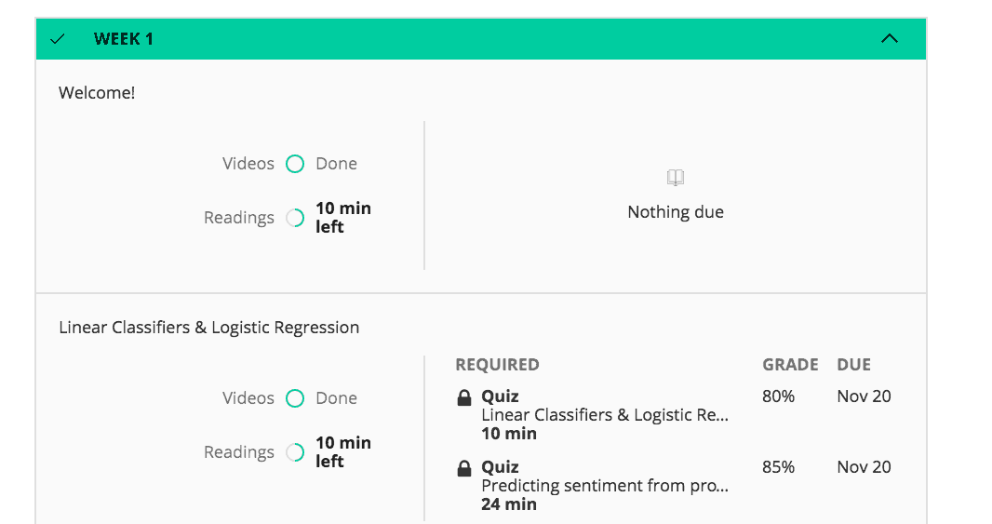
Maintain User Model
The user model explicitly represents the user's knowledge of the system, the user's behavior in terms of expected response time, and other aspects specific to a user or a class of users.
For example, language-learning apps are constantly monitoring areas where a user makes mistakes and then providing additional exercises to correct those behaviors.
A special case of this tactic is commonly found in user interface customization, wherein a user can explicitly modify the system's user model.

Slide 62

Maintain System Model
The system maintains an explicit model of itself. This is used to determine expected system behavior so that appropriate feedback can be given to the user.
A common manifestation of a system model is a progress bar that predicts the time needed to complete the current activity.

Slide 64
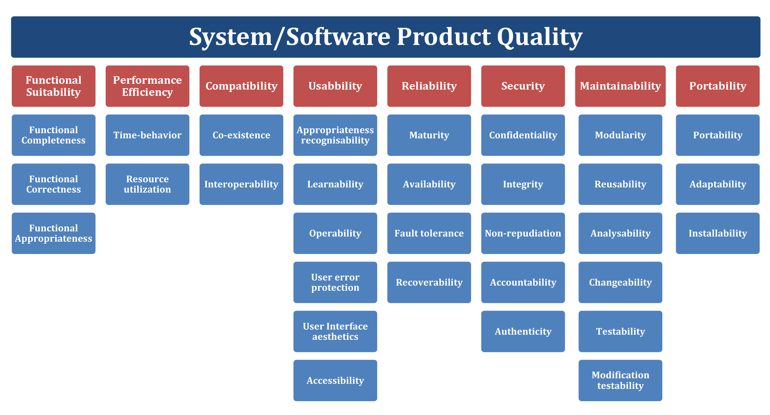
Other Kinds of Quality Attributes
ISO/IEC FCD 25010: Systems and Software Engineering: Systems and Software Product Quality Requirements and Evaluation (SQuaRE): System and Software Quality Models.

Slide 65

Thank You & See You Again

